Slide 1
Class 14: The plain meaning rule

Slide 2
Key questions
Is there an enforceable promise?
Has it been performed?
  Sources of terms
  Rules of construction
  Hierarchy of sources
Has performance been excused?
How should it be enforced?

Slide 3
Overview of rules on extrinsic evidence
Extrinsic evidence cannot be used to:
Vary/contradict integrated [final] written agreements
Add to/supplement completely integrated [final, complete and exclusive] written agreements within their scope
Explain unambiguous agreements
Extrinsic evidence can be used to:
Invalidate a written agreement
Reform a written agreement
Show grounds for granting a remedy
Establish a collateral agreement which either is beyond the scope of, or for some other reason might naturally be omitted from, the writing
Establish the meaning of ambiguous writings
Establish meaning, supplement or qualify, if the evidence relates to commercial context
Establish that performance is subject to a condition

Slide 4
Topics
Types of ambiguity
Rules of construction
California’s approach to the plain meaning rule
New York’s approach to the plain meaning rule
Policy considerations

Slide 5
Ambiguity and vagueness
A word, phrase, sentence or clause is ambiguous if it has more than one sense. It is vague when it has borderline cases.
Technician will not compete “within fifty miles of the Company office.” Does this bar competition at a location that is 45 miles as the crow flies but 55 miles by road?
Seller of photo studio will not compete with the buyer “for school photography work in any school in Grant county, with the exception of Marion High School and Bennett High School.” Does this bar competition for work in Marion College?

Slide 6
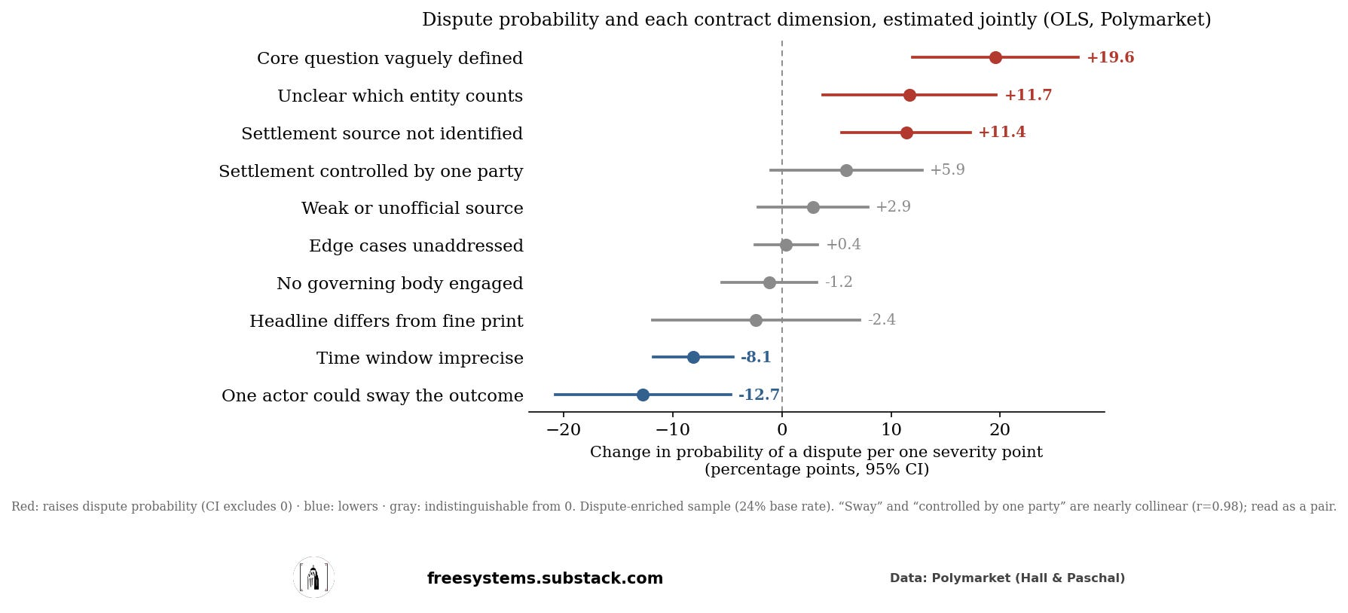
Ambiguity and vagueness

Slide 7
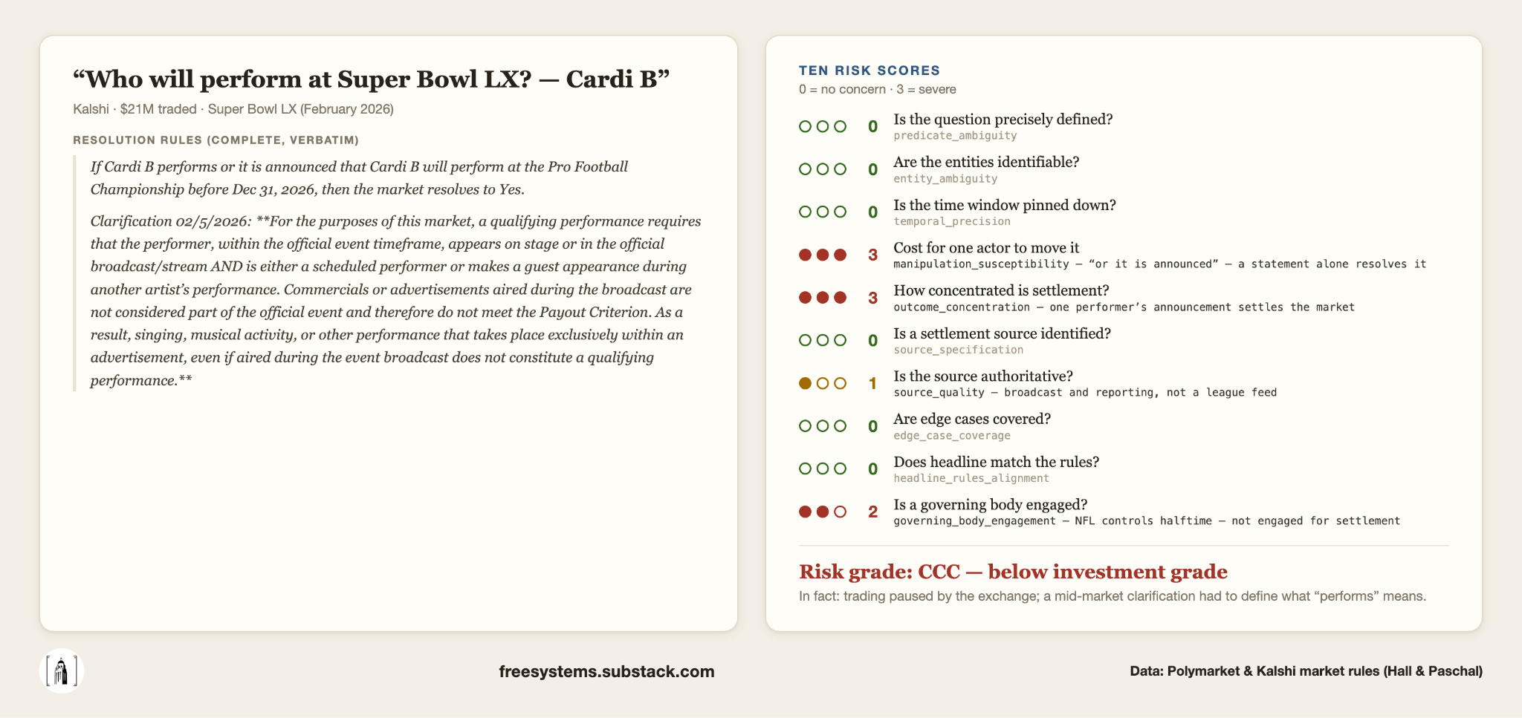
Ambiguity and vagueness

Slide 8
Structural/syntactic ambiguity (566)
“For one year after my employment with you ends, I will not [manage for] any firm who shall have been your client within the period of one year prior to the termination of my employment or with whom you may have been negotiating during my employment by you if I have participated in such negotiations or had contact with that firm in the course of my employment with you.”
Suppose employee moves to a new firm that was a client three months earlier but with which she had no contact?

Slide 9
Structural/syntactic ambiguity (566)
“For one year after my employment with you ends, I will not [manage for] any firm
who shall have been your client within the period of one year prior to the termination of my employment
or
with whom you may have been negotiating during my employment by you
if I
have participated in such negotiations
or
had contact with that firm in the course of my employment with you.”

Slide 10
Structural/syntactic ambiguity (566)
“For one year after my employment with you ends, I will not [manage for] any firm
who shall have been your client within the period of one year prior to the termination of my employment
or
with whom you may have been negotiating during my employment by you
if I
have participated in such negotiations
or
had contact with that firm in the course of my employment with you.”

Slide 11
Structural/syntactic ambiguity (566)
“For one year after my employment with you ends, I will not [manage for] any firm
who shall have been your client within the period of one year prior to the termination of my employment
or
with whom you may have been negotiating during my employment by you
if I
have participated in such negotiations
or
had contact with that firm in the course of my employment with you.”
Notes:
The decision in favor of this interpretation was motivated by the facts that the alternative would render clause c) redundant (participation in negotiations typically implies contact with the other firm) and might be so broad as to contravene public policy because the restriction on working with former clients would not be qualified.

Slide 12
Rules of construction
“Sophisticated lawyers…must be presumed to know how to use parallel construction and identical wording to impart identical meaning when they intend to do so, and how to use different words and construction to establish distinctions in meaning. They must also be presumed to be familiar with standard maxims of contract construction, including the maxim expressio unius est exclusio alterius…”
International Fidelity Insurance Company v. County of Rockland, United States, 98 F.Supp.2d 400, 412 (S.D.N.Y. 2000).

Slide 13
Rules of construction (567)
Purpose
Contract must be read as a whole, consistently, giving meaning to every term
Public interest
Ejusdem generis
Expressio unius est exclusio alterius
Noscitur a sociis
Contra proferentem [often described as a last resort]

Slide 14
Problem (based on problem on 569)
Prospective tenant is a self-professed “animal lover” and currently owns sheep, cows, pigs, cats and dogs. Should landlord draft lease of a farm to state that she is permitted to keep:
“animals”?
“sheep, cows, and pigs”?
“sheep, cows, pigs and other animals”?
What if she wants a guinea pig? A wild boar? A tiger?
Recall: ejusdem generis, expressio unius est exclusio alterius, noscitur a sociis and contra proferentem.

Slide 15
Overview of rules on extrinsic evidence
Extrinsic evidence cannot be used to:
Vary/contradict integrated [final] written agreements
Add to/supplement completely integrated [final, complete and exclusive] written agreements within their scope
Explain unambiguous agreements
Extrinsic evidence can be used to:
Invalidate a written agreement
Reform a written agreement
Show grounds for granting a remedy
Establish a collateral agreement which either is beyond the scope of, or for some other reason might naturally be omitted from, the writing
Establish the meaning of ambiguous writings
Establish meaning, supplement or qualify, if the evidence relates to commercial context
Establish that performance is subject to a condition

Slide 16
Contentious issues
Does/should the parol evidence rule apply to consumer contracts?
Can extrinsic evidence be used to determine whether and to what extent a writing is integrated?
Can extrinsic evidence be used to determine whether a writing is ambiguous?
Can evidence of commercial context always be used to explain or supplement a writing?

Slide 17
Policy considerations
Benefits include:
Cautionary effect
Reduced risk of interpretive error
  Relative ease of interpreting writings
  Biased juries
Reduced reading costs
Reduced litigation costs
Competing considerations:
Increased drafting costs
Frustration of intentions of unsophisticated parties

Slide 18
Pacific Gas & Electric (548)
D agreed to “indemnify [plaintiff] against all loss, damage, expense and liability resulting from…injury to property arising out of or in any way connected with the performance of this contract.”
What meaning did the defendant give to this provision?
What evidence did it offer in support of its interpretation?
How did Traynor justify admission of that evidence? What are the countervailing policy concerns?

Slide 19
Trident Center (560)
“[m]aker shall not have the right to prepay the principal amount hereof in whole or in part [for the first 12 years]”
What meaning did Trident give to this provision?
What evidence did it offer in support of its interpretation?
Does PG&E dictate admission of all such evidence?
Is Trident likely to prevail on the merits?
Is this rule consistent with the intentions of the parties?
Would this rule make more sense for foreign borrowers?
Can parties in California opt out of the PG&E rule?

Slide 20
W.W.W. Associates v. Giancontieri (553)
“… in the event such litigation is not concluded, by or before 6–1–87 either party shall have the right to cancel this contract…”
What meaning did the plaintiff give to this provision?
How did the plaintiffs seek to use the extrinsic evidence?
Would the result have been different under California law?
How did the court’s reasoning differ from California law?

Slide 21
Greenfield v. Philles Records (556)
“All recordings made hereunder and all records and reproductions made therefrom together with the performances embodied therein, shall be entirely [Philles'] property, free of any claims whatsoever by you or any person deriving any rights of interest from you. Without limitation of the foregoing, [Philles] shall have the right to make phonograph records, tape recordings or other reproductions of the performances embodied in such recordings by any method now or hereafter known, and to sell and deal in the same under any trade mark or trade names or labels designated by us, or we may at our election refrain therefrom.”

Slide 22
Greenfield v. Philles Records (556)
What meaning did the plaintiffs give to this provision?
Is the agreement ambiguous? Under California law?
What if it had been ambiguous?
Why was the claim not barred by the 1974 release?
What are the policy justifications for this decision?
How could the Ronettes have protected their interests?

Slide 23
Greenfield v. Philles Records (556)
Per Graffeo J:
“We also reject plaintiffs' assertion that the royalty schedule restricts the scope of defendants' ownership rights. That section of the agreement provides compensation rights to plaintiffs; it does not inhibit defendants' ability to use the master recordings…. We realize that our conclusion here effectively prevents plaintiffs from sharing in the profits that defendants have received from synchronization licensing. However sympathetic plaintiffs’ plight, we cannot resolve the case on that ground under the guise of contract construction. Our guiding principle must be to neutrally apply the rules of contract interpretation because only in this way can we ensure stability in the law and provide guidance to parties weighing the risks and advantages of entering a binding agreement.”

